Slide 1
Few-Shot Learning using Data Augmentation and Transfer Learning
Namit Mohale, Karanpreet Singh Wadhwa
nm3191, ksw352

Slide 2
Let’s talk about VGG & ImageNet, shall we?
ImageNet – One of the most diverse datasets.
VGGNet – One of the most preferred choice for extracting features from images, the perfect blend of simplicity and complexity.
Can also be used to train on your own custom dataset.
VGG-16 network on ImageNet
90% Accuracy 3-4 weeks of training time?

Slide 3
What if you do not wish to spend weeks on training it again for new additional classes?

Slide 4
Thanks to Transfer Learning!
It is the ability to learn novel classes quickly and efficiently using pre-trained models.
Can be used to extract features from pre-trained Conv-Nets to train novel classes on.
But, most of the work yet has been focused on equally large datasets for novel classes, as large as ImageNet or any other popular datasets are.

Slide 5
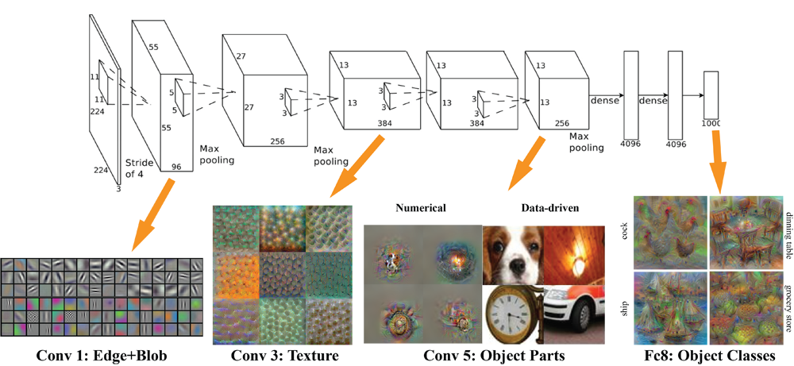
Feature Visualization for VGG-16
Image Source : https://www.cc.gatech.edu/~hays/compvision/proj6/

Slide 6
Scenarios of Transfer Learning
New dataset is small and similar to original dataset.
Since the data is small, it is not a good idea to fine-tune the ConvNet due to overfitting concerns.
Since the data is similar to the original data, we expect higher-level features in the ConvNet to be relevant to this dataset as well. Hence, the best idea might be to train a linear classifier on the CNN codes.New Dataset is large and similar to original dataset.
New dataset is large and similar to the original dataset.
Since we have more data, we can have more confidence that we won’t overfit if we were to try to fine-tune through the full network.
New Dataset is small and very different from the original dataset.
New dataset is small but very different from the original dataset.
Since the data is small, it is likely best to only train a linear classifier.
Since the dataset is very different, it might not be best to train the classifier form the top of the network, which contains more dataset-specific features. Instead, it might work better to train the SVM classifier from activations somewhere earlier in the network.
New dataset is large and very different from the original dataset.
Since the dataset is very large, we may expect that we can afford to train a ConvNet from scratch.
However, in practice it is very often still beneficial to initialize with weights from a pretrained model. In this case, we would have enough data and confidence to fine-tune through the entire network.

Slide 7
What if you do not have as many samples for novel classes?

Slide 8
That is where Augmentation comes in!
We perform geometric and color transformations to the original data.
The transformed images are then added to the original novel data.
Some of the transformations applied are:
Crop
Rotate
Skew
Coarse Pixel Dropout
Gaussian Noise
Flip
Channel Shift
Blur

Slide 9
Introduction
Adequate training of neural networks requires a lot of data.
Today in case of low data regime, existing networks fail to generalize poorly.
We decide to follow Few-Shot learning technique by exploiting aggressive data augmentation and transfer learning.
Instead of incurring the cost of collecting new data for new classes, we apply transformations on the original data to generate new data, augment it to the original data, and transfer the features learned by pre-trained models to our class domain.

Slide 10
Method
We first use geometric and color transformations to create new data.
The transformed data is then augmented to the original data.
The new augmented dataset is then served to the classifier.
We use a VGG-16 model pre-trained on the classic ImageNet1k dataset.
We fine tune the network by unfreezing the last two fully connected layers and training on novel samples.
Our dataset contains 3 seen (Cat, Dog, Human) and 2 unseen (Horse, Robot) classes.

Slide 11
Architecture
Novel Data
Cat
Dog
Horse
Human
Robot
Augmenter
Augmented Data
Fine-Tuned
Classifier
Transformed Data

Slide 12
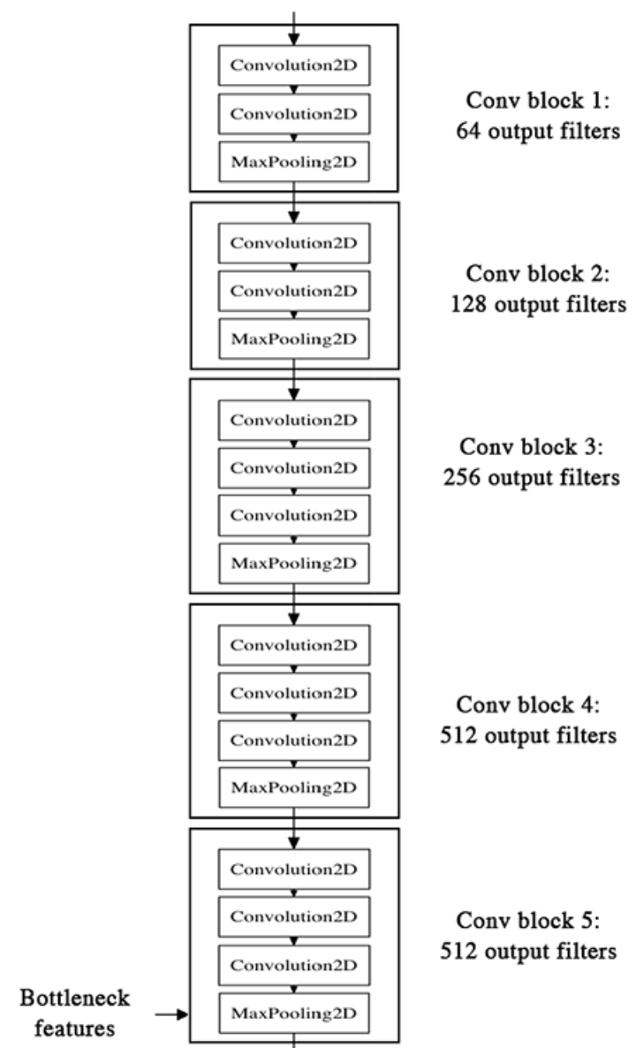
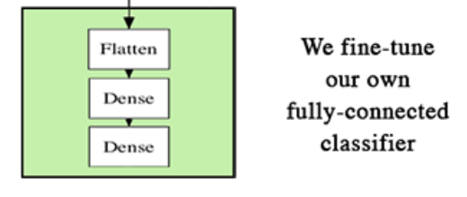
Fine-Tuned VGG-16 Architecture
We reached the conclusion of fine-tuning just the last component of the network.
We also tried fine-tuning Conv Block 5 and Fully-connected classifier, but the accuracy went down since the samples were not diverse enough for so many parameters to be learnt from.
Image source - https://blog.keras.io/building-powerful-image-classification-models-using-very-little-data.html

Slide 13
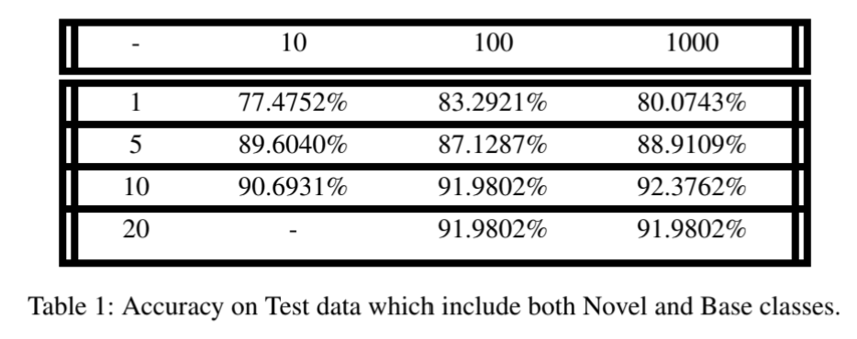
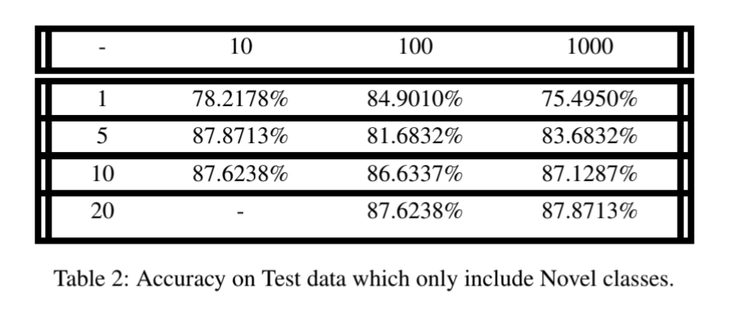
Results
We generated 10, 100 and 1000 new samples from 1, 5, 10 and 20 novel samples per class.
Fine-tuned VGG-16 was then trained on novel + base classes and novel classes only, separately.
Augmentations
Augmentations
Original Samples
Original Samples

Slide 14
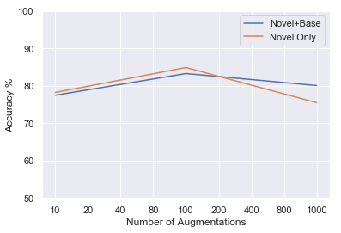
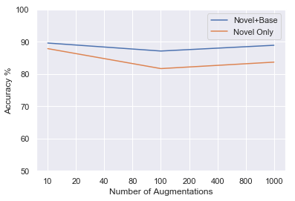
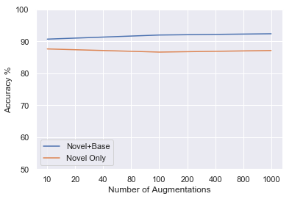
Result Analysis
The trend in accuracies for the novel classes alone lie close to Base + Novel classes which clearly reflects that the VGG-16 model is learning the features of novel classes after training the last layer only.
Accuracy vs Number of Augmented Image
from 1 Image
Accuracy vs Number of Augmented Image
from 5 Images
Accuracy vs Number of Augmented Image
from 10 Images

Slide 15
Future Work
While traditional augmentation is very effective alone, other techniques enabled by CycleGAN and other similar networks are promising.
Although GANs and neural augmentations do not perform much better than traditional augmentations and consume almost 3x the compute time or more, we can always combine data augmentation techniques.
“Style” transfer can be used to augment data in situations were the available data set is unbalanced.
We would also like to explore the applicability of this technique to videos. Specifically, it is a well known challenge to collect video data in different conditions (night, rain, fog) which can be used to train self-driving vehicles.

